Slide 1






IMPROVING FOOD TOGETHER
IMPROVING FOOD TOGETHER
Are you…
An SME making an impact in the agrifood sector?
Generating revenues from your products or services?
Seeking non-dilutive funding to grow?
If so, EIT Food has a new opportunity for you!

Slide 2
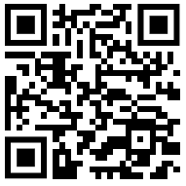

IMPROVING FOOD TOGETHER
FAST TRACK TO MARKET
Introducing the Fast Track to Market Programme
A new opportunity to get your agrifood innovation, product, or service to market quicker and enhance your commercial success.
€250k per ticket
available for each start-up, with a call budget of €2M
Revenue-share
financing with a capped maximum return
Fast capital
no need for extensive negotiations or valuations
Simple
application, fast evaluation, and minimal reporting
30% co-funding
required for total project costs
12 months
for execution of selected projects

Slide 3





IMPROVING FOOD TOGETHER
FAST TRACK TO MARKET
IMPROVING FOOD TOGETHER
WHAT DO I GAIN?
Join the largest food innovation community
Achieve your next milestone
Expand your sales footprint
Access smart money
Keep your equity intact
HOW?
EIT Food provides you with a founder-friendly financing scheme by giving your company a large cash injection in exchange for a small percentage of your company’s future revenues
WHAT IS THE RETURN?
After receiving your funding, you will have one year to complete your project, with no success-sharing required (i.e., honeymoon). Afterwards, you return a percentage of your company’s revenues over 5 years, capped to a maximum amount

Slide 4
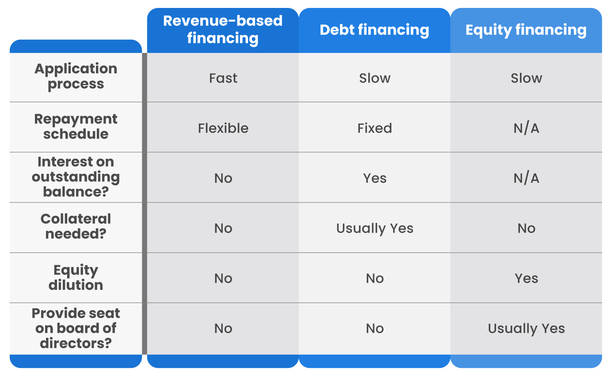
IMPROVING FOOD TOGETHER
COMPARISON WITH OTHER INSTRUMENTS
Bank Loan
Fast
Slow; hard to get
Repayment terms
Flexible
No
No
No
No
Cost of Capital
Medium
Low
High

Slide 5






IMPROVING FOOD TOGETHER
TIMELINE
1
2
3
4
5
6
Company submits an application
Is selected for funding
Has one year to launch new product(s)
Completes project and submits documents
Begins revenue sharing
Returns up to a maximum amount over 5 years
Only four sections required
Up to €250k per start-up
No payments necessary during project (i.e., honeymoon)
Minimal reporting requirements
Fixed, negotiated percentage
Max 8.50% premium per year

Slide 6
IMPROVING FOOD TOGETHER
SUCCESS PREMIUM
Success premium of 8.50% per year, meaning…
PREMIUM
AWARD
MAX TOTAL REPAID
If complete within one year:
ILLUSTRATIVE EXAMPLE
8.5%
100%
108.5%
Company receives €200k award and has one year for their project
Agrees to 5% share of its half yearly revenues (€700k) after project ends: €35,000 per semester
By sharing 5% every 6 months, Company would take four years to complete success-sharing
Therefore, it will expect to pay 134%: €268k
It therefore had an effective cost of capital of only 6.80% per year!
If complete within two years:
17%
100%
117%
If complete within three years:
25.5%
100%
125.5%
If complete within four years:
34%
100%
134%
MAX!
If complete within five years:
42.5%
100%
142.5%
Companies can always choose to pay more earlier to reduce their premium!

Slide 7
IMPROVING FOOD TOGETHER
REVENUE-BASED FINANCING – STEP BY STEP
1
CONTRACTING
2
FINANCING
3
PROJ. EXECUTION
4
COMPLETION
Company and EIT Food agree to a revenue-sharing percentage before project begins
After signatures, Company receives 80% of the Award to begin its project
Company begins project execution and is not expected to repay for 12 months (i.e., grace period)
Company completes project and submits all necessary documentation, including financial statements
5
RETAINER
6
CALCULATION
7
INVOICES
8
PREMIUM
Once EIT Food validates project completion, the remaining 20% is disbursed
EIT Food, using the agreed revenue-sharing percentage and the financial statements, calculates the amount to be paid for the next 6 months
EIT Food sends monthly invoices, each equal to a portion (1 of 6) of the amount calculated in Step 6
Company continues to pay until it completes the entire Award amount plus a premium of 8,50% per year

Slide 8
IMPROVING FOOD TOGETHER
TERMS
Key Terms | Revenue-Based Financing
Scheme | Flexible revenue-sharing based on the company’s top-line revenues, including the possibility to adapt duration terms according to business performance and speeds of generating revenues, including no penalties for earlier completion.
Award amount | Up to 250.000 EUR (80% disbursed at beginning of project, 20% disbursed at project completion)
Maximum Threshold | The amount that will be shared with EIT Food. It is equal to the Award amount plus a premium of 8,50 per cent per year in which the RBF is in effect
Reward payments | Monthly success sharing payments, equal to a negotiated % of the company’s revenues calculated every 6 months
Grace period | No reward payments are required during project execution (up to 12 months)
Maximum Completion Date | Maximum 6 years from signature date
Premium | The premium is equal to 8,50 per cent of the Award amount per year in which the RBF is still outstanding. In other words, for every year in which the RBF is still in effect, the total Maximum Threshold increases by a factor of 8,50 per cent. For example: Assuming an Award amount of 250.000 EUR, the company will start to pay a percentage of their revenues each month. With those payments: If the Maximum Threshold is reached within 1 year after project completion, the company will pay a total of 271.250 EUR If the Maximum Threshold is reached within 2 years after project completion, the company will pay a total of 292.500 EUR If the Maximum Threshold is reached within 3 years after project completion, the company will pay a total of 313.750 EUR If the Maximum Threshold is reached within 4 years after project completion, the company will pay a total of 335.000 EUR If the Maximum Threshold is reached within 5 years after project completion, the company will pay a total of 356.200 EUR As such, EIT Food encourages faster payment for selected participants.
Covenants | Must adhere to regular project monitoring and compliance with Horizon Europe funding rules (e.g., restrictions on CAPEX expenditure)
Additional rights | As long as the RBF is in effect, EIT Food is keen on having the same information rights as members of the applicants’ Managing Board. In addition, EIT Food reserves the right to invite one Board Observer to the meetings of the applicants’ Managing Board.

Slide 9







IMPORTANT THINGS TO KNOW
Financial return is based on the company’s total revenues, not just the product or solution in question
The return premium is capped to 8,50% per year to a maximum of 5 years. Therefore, larger payments earlier on decreases the total amount paid.
Payment must be made within 5 years of completing the Fast Track project
Each payment will be equal to an agreed percentage of the company’s revenues, calculated as the top-line revenues of the 6 preceding months. Amounts are subject to negotiation.
Invoices are sent monthly – the exact amount is calculated every 6 months based on the percentage agreed during negotiations.
EIT Food shall have the right to invite one Observer to attend the meetings of the board of directors without voting rights and, where applicable, the shareholders’ meetings of the Company
Failure to repay constitutes a breach of contract and is subject to further legal recourse, as outlined by a signed agreement between EIT Food and the Company

Slide 10
IMPROVING FOOD TOGETHER
ILLUSTRATIVE EXAMPLE
PROJECT INTAKE PROCESS
FAST TRACK APPLICATION
PROJECT EXECUTION
Company A
€500k in yearly revenues
Submits project proposal for market expansion into Germany
After evaluations and panels, Company A is awarded for funding
5 employees
Activities include hiring local sales staff, increasing production, and developing marketing materials
After due diligence and validation, Company A signs RBF agreement for 5% revenue-share
Growing at ~30% year-over-year
Portfolio of dairy-free cheeses
Project timeline is 10 months, from January 2025 to October 2025
Company A receives €161k as pre-financing, which is 80% of the award
Currently only present in Sweden
Estimates total costs to be €300k, 70% of which can be funded by EIT Food (€210k)
Company A begins execution, reporting progress with EIT Food
Willing to engage in 5% revenue-sharing

Slide 11

IMPROVING FOOD TOGETHER
ILLUSTRATIVE EXAMPLE (CONT.)
PROJECT COMPLETION AND REPAYMENT
PROJECT COMPLETION
REVENUE SHARING BEGINS
REPAYMENT PREMIUM
Company A completes project in October 2025, submitting all the necessary documentation
EIT Food calculates the revenue-share portion for the following 6 months to be €12,500
6 months later, Company A submits their updated financial statements
Company A’s Half-Yearly revenues are now €300k (€600k annualized)
Once EIT Food validates completion, Company A receives remaining €42k (20%)
EIT Food allocates the portion into equal monthly amounts of €2,083
EIT Food updates invoice amount to €2,500 every month for the next 6 months
Company A attests to their Half-Yearly revenues: €250k (€500k annualized)
EIT Food invoices Company A €2,083 every month for the next 6 months
Company A continues to pay until it repays €210k plus a premium of 8,50% per year (€17,850 per year)
Company A also submits their consolidated financial statements

